Slide 1
Development
Dr. Kamal Beydoun
Faculty of Sciences I
Lebanese University
A good programmer is someone who always looks both ways before
crossing a one‐way street.
—Doug Linder
Always code as if the guy who ends up maintaining your code will be a
violent psychopath who knows where you live.
—Martin Golding

Slide 2

Introduction
Development is the heart of software engineering.
Without development, there is no application.
It’s best to test software early and often.
Bugs are easiest to find and fix if they’re detected soon after they’re created.
Some specific techniques that you can use to make your code easier to debug and maintain.

Slide 3
USE THE RIGHT TOOLS
Including overhead (office space, computer hardware, network hardware, Internet service provider, vacation, sick time, etc), employing a programmer can easily cost more than $100,000 per year.
Some managers refuse to spend a few hundred bucks for proper programming tools !
Next, we will describe some of the development tools that every programmer should have.

Slide 4
USE THE RIGHT TOOLS
Hardware
Programmers need fast computers with lots of memory and disk space.
takes shorter to do everything.
Two drawbacks
Some programmers will go overboard and buy all sorts of fun toys
Forget that their users may not have such nice equipment.
Network
Allow programmers to have free access to the Internet.
Often a quick search can find a solution to a programming problem that would otherwise take hours to solve.
You should gently encourage staff members not to spend their whole day playing or in chat rooms.
Notes:
Breaking the writing process into dozens of chunks separated by several minutes of thumb twiddling (or more likely, trips to the water cooler) breaks the programmer’s train of thought, so he needs to re‐create an understanding of the code each time.

Slide 5
USE THE RIGHT TOOLS
Development Environment
The minimum necessary to make programming possible.
It at least includes the compiler or interpreter.
No need for the fanciest development environment possible.
Source Code Control
It enables you to go back through past versions of the software and see exactly what changes were made and when.
It prevents multiple programmers from tripping over each other as they try to modify the same code at the same time.

Slide 6
USE THE RIGHT TOOLS
Profilers
let you determine what parts of the program use the most time, memory, files, or other resources.
No need to buy every programmer a profiler. Typically, a small part of a program’s code determines its overall performance
Static Analysis Tools
Static analysis tools study code without executing program (how interconnected different pieces of code, how complex a piece of code is, average the number of lines of code per method, etc.).
Testing Tools
Testing tools, particularly automated tools, can make testing a whole lot faster, easier, and more reliable.
Notes:
Static Analysis Tools
For example, They can measure how interconnected different pieces of code are or how complex a piece of code is.
They can also calculate statistics that may indicate code quality and maintainability such as the number of comments per line of code and average the number of lines of code per method.

Slide 7
USE THE RIGHT TOOLS
Source Code Formatters
Some development environments do a better job of formatting code than others.
It makes code easier to read and understand.
Refactoring Tools
Rearranging code to make it easier to understand, more maintainable, or generally better.
Define new classes or methods, or extract a chunk of code into a new method (existing code).
Training
makes programmers more effective and keeps them happy.
can greatly improve performance and help you retain your staff.
Notes:
a separate code formatter can standardize indentation, align and reformat comments, break code so it fits on a printout, enforce some code standards, and more.

Slide 8
USE THE RIGHT TOOLS
SELECTING ALGORITHMS : many efficient algorithms have been developed to solve problems such as the following:
Sorting and arranging pieces of data
Quickly locating items in databases
Finding optimal paths through street, power, communication, or other networks
Designing networks to provide necessary capacity and redundancy to prevent single points of failure
Encrypting and decrypting data
Finding least cost construction and production strategies

Slide 9
USE THE RIGHT TOOLS
SELECTING ALGORITHMS : the characteristics that make an algorithm a good choice for you.
Effective :
If you can’t find an algorithm that fits your problem, and you can’t adjust your problem to fi t the available algorithms, then you may need to write your own algorithm or modify an existing one.
Be sure to perform extra testing to make sure it works correctly.
Efficient
To be useful, an algorithm must satisfy your speed, memory, disk space, and other requirements.
Predictable
Some algorithms produce nice, predictable results every time they run. Other algorithms may be less predictable.
Simple
Ideally an algorithm, like any other piece of code, should be elegantly simple. Simple code is easy to understand and easy to debug.
Prepackaged
An algorithm that is implemented inside your programming language or in a library, use it.
Prepackaged algorithms also tend to be more thoroughly studied and tested than anything you have time to write.

Slide 10
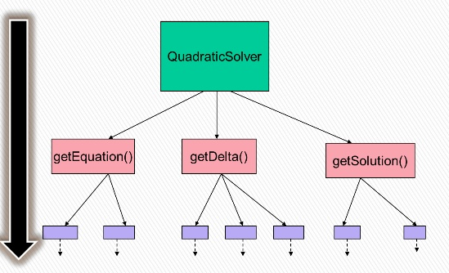
TOP‐DOWN DESIGN
Start with a high‐level statement of a problem, and break the problem down into more detailed pieces.
Examine and continue breaking pieces into smaller pieces until you have a detailed list of the steps.
Continue performing rounds of refinement, providing more detail for any steps that aren’t painfully clear, until the instructions are so detailed a fifth-grader could follow them.
At that point, sit down and write the code.

Slide 11
PROGRAMMING TIPS AND TRICKS
Be Alert
To know if you’re writing the code correctly, you need to completely understand what you’re trying to do, what the code actually does, and what could go wrong.
You can make your life a little easier if you write code only while you’re wide awake and alert.
Write for People, Not the Computer
In fact, the computer doesn’t even read your code.
Debugging and maintaining code is far more difficult and time‐consuming than writing code in the first place.
To make debugging and maintaining code easier, you need to write code that is clear and easy to understand.

Slide 12
PROGRAMMING TIPS AND TRICKS
Comment First
Many programmers write the bare minimum of comments because they think that writing lots of comments is a waste of time. Two bad ways of writing comments :
Write comments as you code.
Write all the code without comments. Then, write comments.
The real problem is that you’re trying to write comments to explain what the code does and not what it should do .
One way to write comments that explain what the program is supposed to be doing is to write the comments first.
Remember, you might be debugging this code in a year or two.
Notes:
Many programmers use one of two models for writing comments. The first approach is to write comments as you code. You write a loop and then put a comment on top of it. Later you realize that the loop isn’t quite right, so you change it and then update the comment. A bit later you realize that the loop
still isn’t right, so you change it again and revise the comment once more. After 37 rounds of revisions, you’ve either spent a huge amount of time updating the comment, or you’ve given up (thinking you’ll revise the comment later) and the comment is hopelessly disconnected from the final code.
The second strategy is to write all the code without comments. When you’re finished with your 37 revisions, you go back and insert the bare minimum number of comments that you think you can get away with without getting yelled at by the lead developer. (The lead developer does the same thing, so he doesn’t care all that much about comments anyway.)

Slide 13
PROGRAMMING TIPS AND TRICKS
Write Self‐Documenting Code
Use descriptive names for classes, methods, properties, variables, and anything else you possibly can.
Don’t use magic numbers (value that just appears in the code with no explanation).
Keep It Small
Write code in small pieces. Long pieces of code are harder to read.
Stay Focused
Each class should represent a single concept that’s intuitively easy to understand.
If you can’t describe a class in a single sentence, then it’s probably trying to do too much, and you should consider splitting it into several related classes.
Notes:
Instead of using a magic number, use a named constant that has the same value.
Better still, if your language supports enumerated types, use them. They also give names to magic numbers and some development environments can use them to enforce type rules.
---------------

Slide 14
PROGRAMMING TIPS AND TRICKS
Avoid Side Effects
A side effect is an unexpected result of a method call.
Validate Results
Add validation code to your methods.
It should examine the input data to make sure it’s correct, and it should verify that the result your code produces is right.
The main tool for validating code is the assertion.
Notes:
For example, suppose you write a ValidateLogin method that checks a username and password in the database to see if the combination is valid. Oh, and by the way, it also leaves the application connected to the database. Leaving the database open is a side effect that isn’t obvious from the name of the ValidateLogin method.
------------------------------
An assertion is a statement about the program and its data that is supposed to be true. If it isn’t, the assertion throws an exception to tell you that
something is wrong.

Slide 15
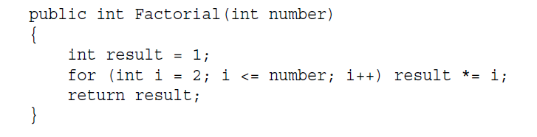
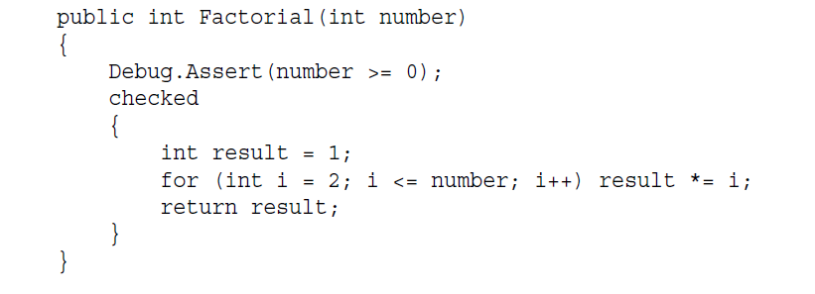
PROGRAMMING TIPS AND TRICKS
Practice Offensive Programming
The idea behind defensive programming is to make code working no matter what kind of garbage is passed into it for data. The code should work and produce some kind of result no matter what.
The call to Debug.Assert throws an exception if its condition is false .
The checked block throws an exception if the calculations cause integer overflow.
Offensive Programming

Slide 16
PROGRAMMING TIPS AND TRICKS
Use Exceptions
An exception interrupts the program’s execution and forces the code to take action.
If you don’t have any error handling code in place, the program crashes.
Write Exception Handlers First
To create better error handlers is to follow the same strategy you can use when writing comments and validation code: Do it first.
When you start writing a method, paste in all the comments that you got from top‐down design, add code to validate the inputs and verify the outputs, and then wrap error handling code around the whole thing.

Slide 17
PROGRAMMING TIPS AND TRICKS
Don’t Repeat Code
If you find that you’re writing the same (or nearly the same) piece of code more than once, consider moving it into a separate method that you can call from multiple places.
Defer Optimization
First make it work. Then make it faster if necessary.
Highly optimized code can be a lot of fun to write, but it can also be very confusing.
That means it takes longer to write and test. It’s also harder to read, so it’s harder to debug and fix if there is a problem.
Before you start optimizing code, make sure it works properly. Then if you do find that performance is insufficient, carefully analyze the problem (using a profiler if you can) so that you don’t waste time optimizing code that is already fast enough.

Slide 18

Video : Eclipse Introduction

Slide 19

Video : IDE Overview

Slide 20

Video : Plug-Ins

Slide 21

Video : Eclipse Demo Create Java Project

Slide 22
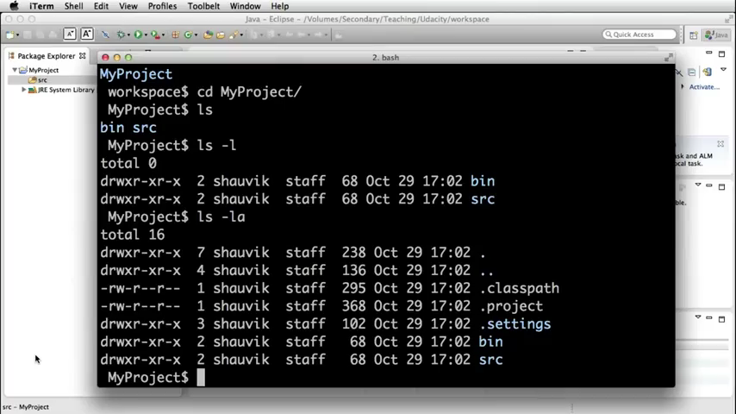
Video : Eclipse Demo Create Java Project

Slide 23
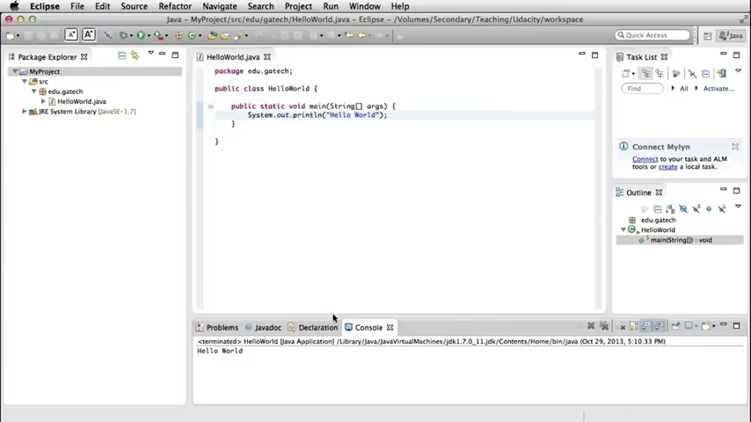
Video : Eclipse Demo Run Configuration

Slide 24
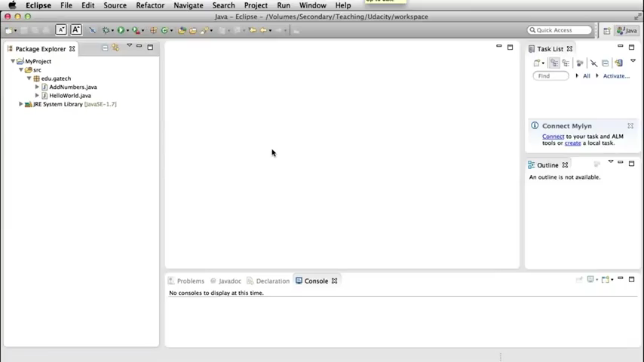
Video : Eclipse Demo Debugging

